Slide 1
Support Vector Machine

Slide 2
Outline
Hinge Loss
Support Vector Machine (SVM)
Kernel Method

Slide 3


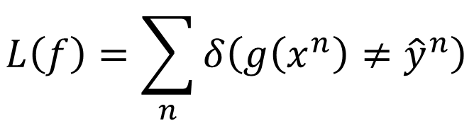


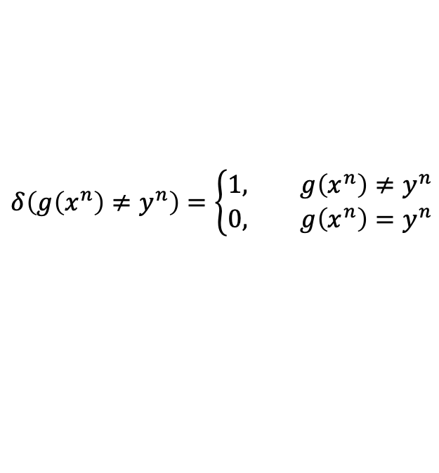








Binary Classification
$$x^{1}$$
$$x^{2}$$
$$x^{3}$$
$$……$$
$${\hat{y}}^{1}$$
$${\hat{y}}^{2}$$
$${\hat{y}}^{3}$$
$${\hat{y}}^{n}=+1,−1$$
Step 1: Function set (Model)
Step 2: Loss function:
Step 3: Training by gradient descent is difficult
$$f\left(x\right)>0$$
Output = +1
$$g\left(x\right)=$$
$$f\left(x\right)<0$$
Output = -1
$$L\left(f\right)=\sum_{n}{δ\left(g\left(x^{n}\right)≠{\hat{y}}^{n}\right)}$$
The number of times g get incorrect results on training data.
$$l\left(f\left(x^{n}\right),{\hat{y}}^{n}\right)$$
$$δ\left(g\left(x^{n}\right)≠y^{n}\right)=\left\{\begin{aligned}1, g\left(x^{n}\right)≠y^{n} \\ &0, g\left(x^{n}\right)=y^{n}\end{aligned}\right.$$
Notes:
The number of times g get incorrect results on training data. g在训练数据上得到错误结果的次数。

Slide 4
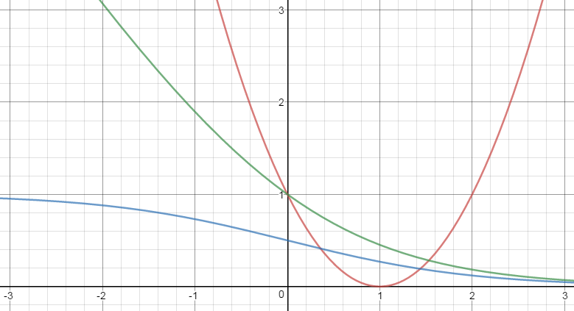

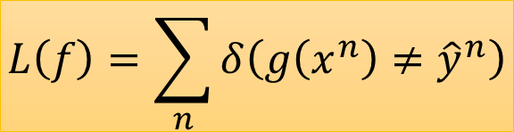





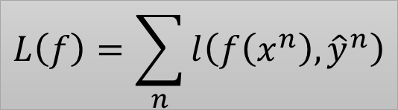
Step 2: Loss function
$$f\left(x\right)>0$$
Output = +1
$$g\left(x\right)=$$
$$f\left(x\right)<0$$
Output = -1
Ideal loss:
Approximation:
$$L\left(f\right)=\sum_{n}{δ\left(g\left(x^{n}\right)≠{\hat{y}}^{n}\right)}$$
$$L\left(f\right)=\sum_{n}{l\left(f\left(x^{n}\right),{\hat{y}}^{n}\right)}$$
$$l\left(f\left(x^{n}\right),{\hat{y}}^{n}\right)$$
Ideal loss
$$δ\left(g\left(x^{n}\right)≠{\hat{y}}^{n}\right)$$
Larger value, smaller loss
$${\hat{y}}^{n}f\left(x^{n}\right)$$
Notes:
Approximation 近似

Slide 5
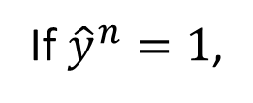

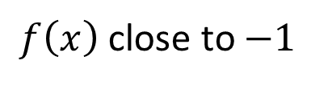

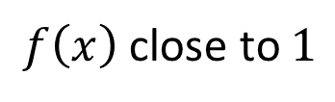


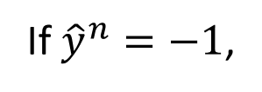
Step 2: Loss function
If ${\hat{y}}^{n}=1$,
$f\left(x\right)$close to $1$
Square Loss:
If ${\hat{y}}^{n}=−1$,
$f\left(x\right)$close to $−1$
$${\left(f\left(x^{n}\right) −1\right)}^{2}$$
$$l\left(f\left(x^{n}\right),{\hat{y}}^{n}\right)={\left({\hat{y}}^{n}f\left(x^{n}\right) −1\right)}^{2}$$
$${\left(−f\left(x^{n}\right) −1\right)}^{2}$$
$${\left(f\left(x^{n}\right) +1\right)}^{2}$$
$$l\left(f\left(x^{n}\right),{\hat{y}}^{n}\right)$$
Square loss
不合理 …
Ideal loss
Larger value, smaller loss
$${\hat{y}}^{n}f\left(x^{n}\right)$$

Slide 6

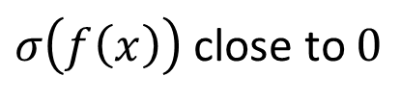

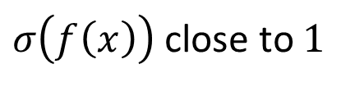



Step 2: Loss function
If ${\hat{y}}^{n}=1$,
$σ\left(f\left(x\right)\right)$ close to $1$
Sigmoid + Square Loss:
If ${\hat{y}}^{n}=−1$,
$σ\left(f\left(x\right)\right)$ close to $0$
$${\left(σ\left(f\left(x^{n}\right)\right)−1\right)}^{2}$$
$$l\left(f\left(x^{n}\right),{\hat{y}}^{n}\right)={\left(σ\left({\hat{y}}^{n}f\left(x^{n}\right)\right)−1\right)}^{2}$$
$${\left(σ\left(−f\left(x^{n}\right)\right)−1\right)}^{2}$$
$${\left(1−σ\left(f\left(x^{n}\right)\right)−1\right)}^{2}$$
$${\left(σ\left(f\left(x^{n}\right)\right)\right)}^{2}$$
Square loss
Ideal loss
Sigmoid + Square loss
Larger value, smaller loss
$${\hat{y}}^{n}f\left(x^{n}\right)$$

Slide 7




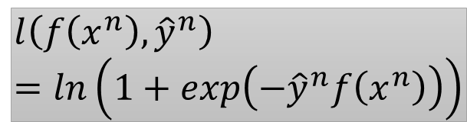
Step 2: Loss function
Sigmoid + cross entropy
(logistic regression)
$${\hat{y}}^{n}=+1$$
$$σ\left(f\left(x^{n}\right)\right)$$
Ground
Truth
cross entropy
1.0
$${\hat{y}}^{n}=−1$$
$$1−σ\left(f\left(x^{n}\right)\right)$$
努力可以
有回報
$$l\left(f\left(x^{n}\right),{\hat{y}}^{n}\right)=ln\left(1+exp\left(−{\hat{y}}^{n}f\left(x^{n}\right)\right)\right)$$
Sigmoid + cross entropy
Square loss
Ideal loss
Sigmoid + Square loss
Divided by ln2 here
沒有回報
不想努力
Larger value, smaller loss
$${\hat{y}}^{n}f\left(x^{n}\right)$$

Slide 8





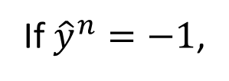

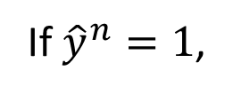

Step 2: Loss function
$$l\left(f\left(x^{n}\right),{\hat{y}}^{n}\right)=max\left(0,1−{\hat{y}}^{n}f\left(x^{n}\right)\right)$$
If ${\hat{y}}^{n}=1$,
$$max\left(0,1−f\left(x^{n}\right)\right)$$
$$1−f\left(x^{n}\right)<0$$
$$f\left(x^{n}\right)>1$$
If ${\hat{y}}^{n}=−1$,
$$max\left(0,1+f\left(x^{n}\right)\right)$$
$$1+f\left(x^{n}\right)<0$$
$$f\left(x^{n}\right)<−1$$
Hinge Loss
及格就好
Sigmoid + cross entropy
Square loss
好還要更好
Ideal loss
Sigmoid + Square loss
$${\hat{y}}^{n}f\left(x^{n}\right)$$
Larger value, smaller loss
penalty
Good enough
Notes:
penalty
因违反法律、规定或合同而受到的)处罚, 刑罚;
(行为、环境带来的)不利后果, 苦难;
(体育运动中对犯规者的)判罚, 处罚;
(足球、橄榄球及类似运动中的)罚球;
(桥牌)(叫牌者未完成定约时的)罚分

Slide 9


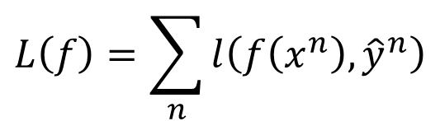


Linear SVM
Compared with logistic regression, linear SVM has different loss function
Deep version:
Yichuan Tang , “Deep Learning using Linear Support Vector Machines”, ICML 2013 Challenges in Representation Learning Workshop
Step 1: Function (Model)
Step 2: Loss function
Step 3: gradient descent?
New w
$$f\left(x\right)=\sum_{i}{w_{i}x_{i}}+b$$
$$=\left[\begin{aligned}w \\ b\end{aligned}\right]∙\left[\begin{aligned}x \\ 1\end{aligned}\right]$$
$$=w^{T}x$$
New x
$$L\left(f\right)=\sum_{n}{l\left(f\left(x^{n}\right),{\hat{y}}^{n}\right)}$$
$$+λ{\left\|w\right\|}_{2}$$
convex
$$l\left(f\left(x^{n}\right),{\hat{y}}^{n}\right)=max\left(0,1−{\hat{y}}^{n}f\left(x^{n}\right)\right)$$
Recall relu, maxout network
Shai Shalev-Shwartz, Yoram Singer, Nathan Srebro, “Pegasos: Primal Estimated sub-GrAdient SOlver for SVM“, ICML, 2007
Notes:
convex 凸

Slide 10


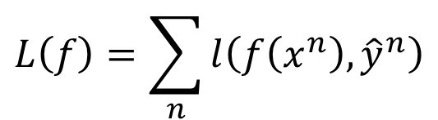
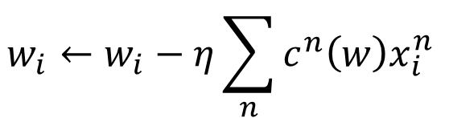
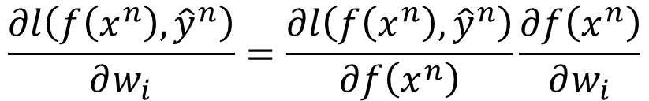

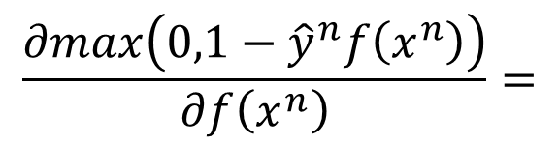
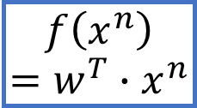

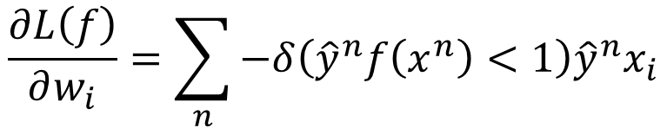
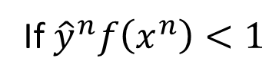

Linear SVM – gradient descent
Ignore regularization for simplicity
$$L\left(f\right)=\sum_{n}{l\left(f\left(x^{n}\right),{\hat{y}}^{n}\right)}$$
$$l\left(f\left(x^{n}\right),{\hat{y}}^{n}\right)=max\left(0,1−{\hat{y}}^{n}f\left(x^{n}\right)\right)$$
$$\frac{∂l\left(f\left(x^{n}\right),{\hat{y}}^{n}\right)}{∂w_{i}}=\frac{∂l\left(f\left(x^{n}\right),{\hat{y}}^{n}\right)}{∂f\left(x^{n}\right)}\frac{∂f\left(x^{n}\right)}{∂w_{i}}$$
$$f\left(x^{n}\right)$$
$$=w^{T}∙x^{n}$$
$$x_{i}^{n}$$
$$\frac{∂max\left(0,1−{\hat{y}}^{n}f\left(x^{n}\right)\right)}{∂f\left(x^{n}\right)}=$$
$$−{\hat{y}}^{n}$$
If ${\hat{y}}^{n}f\left(x^{n}\right)<1$
$$1−{\hat{y}}^{n}f\left(x^{n}\right)>0$$
$$0$$
otherwise
$$\frac{∂L\left(f\right)}{∂w_{i}}=\sum_{n}{−δ\left({\hat{y}}^{n}f\left(x^{n}\right)<1\right){\hat{y}}^{n}x_{i}}$$
$$w_{i}←w_{i}−η\sum_{n}{c^{n}\left(w\right)x_{i}^{n} }$$
$$c^{n}\left(w\right)$$

Slide 11



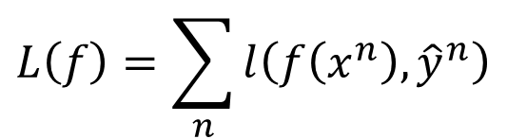




Linear SVM – another formulation
Minimizing loss function L:
$$L\left(f\right)=\sum_{n}{l\left(f\left(x^{n}\right),{\hat{y}}^{n}\right)}$$
$$ε^{n}$$
$$+λ{\left\|w\right\|}_{2}$$
$ε^{n}$: slack variable
$$ε^{n}=max\left(0,1−{\hat{y}}^{n}f\left(x^{n}\right)\right)$$
Quadratic Programming (QP) Problem
=
$$ε^{n}≥0$$
$$ε^{n}≥1−{\hat{y}}^{n}f\left(x^{n}\right)$$
$${\hat{y}}^{n}f\left(x^{n}\right)≥1−ε^{n}$$

Slide 12
Outline
Hinge Loss
Support Vector Machine (SVM)
Kernel Method

Slide 13
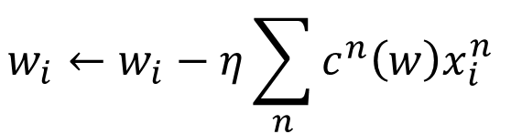
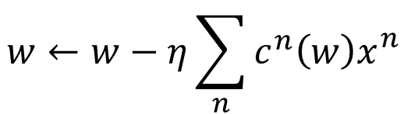


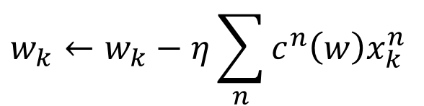
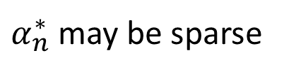
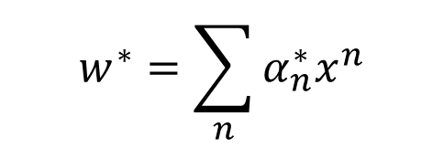
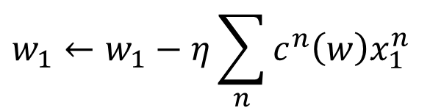
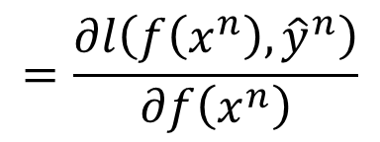
Dual Representation
$$w^{∗}=\sum_{n}{α_{n}^{∗}x^{n}}$$
Linear combination of data points
$α_{n}^{∗}$ may be sparse
$x_{}^{n}$ with non-zero $α_{n}^{∗}$ are support vectors
If w initialized as 0
$$w_{1}←w_{1}−η\sum_{n}{c^{n}\left(w\right)x_{1}^{n} }$$
$$w←w−η\sum_{n}{c^{n}\left(w\right)x_{}^{n}}$$
……
$$w_{i}←w_{i}−η\sum_{n}{c^{n}\left(w\right)x_{i}^{n} }$$
$$c^{n}\left(w\right)$$
$$=\frac{∂l\left(f\left(x^{n}\right),{\hat{y}}^{n}\right)}{∂f\left(x^{n}\right)}$$
Hinge loss: usually zero
……
$$w_{k}←w_{k}−η\sum_{n}{c^{n}\left(w\right)x_{k}^{n} }$$
c.f. for logistic regression, it is always non-zero
Notes:
Dual Representation 二元表示

Slide 14



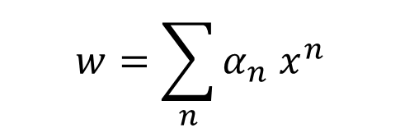


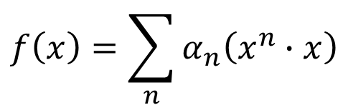







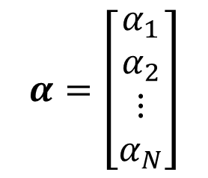

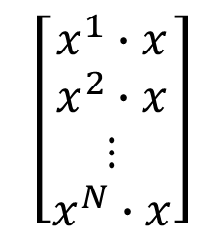
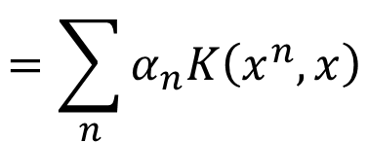
Dual Representation
$$α=\left[\begin{aligned}α_{1} \\ α_{2} \\ ⋮ \\ α_{N}\end{aligned}\right]$$
$$w=\sum_{n}{α_{n}^{}x^{n}}$$
$$x^{1}$$
$$x^{2}$$
$$x^{N}$$
$$=Xα$$
$$X=$$
……
$$w=Xα$$
Step 1:
$$f\left(x\right)=w^{T}x$$
$$f\left(x\right)=α^{T}X^{T}x$$
$$\left[\begin{matrix}α_{1} & ⋯ & α_{N}\end{matrix}\right]$$
$$x$$
$$f\left(x\right)=\sum_{n}{α_{n}\left(x^{n}∙x\right)}$$
$$x^{1}$$
$$x^{2}$$
$$\left[\begin{aligned}x^{1}∙x \\ x^{2}∙x \\ ⋮ \\ x^{N}∙x\end{aligned}\right]$$
……
$$=\sum_{n}{α_{n}K\left(x^{n},x\right)}$$
$$x^{N}$$
Notes:
$α_{n}$ is the unknown parameters to be found

Slide 15

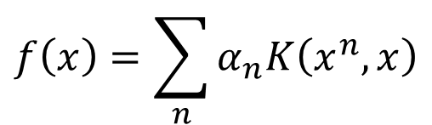

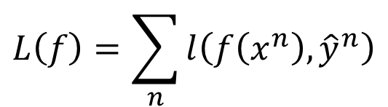
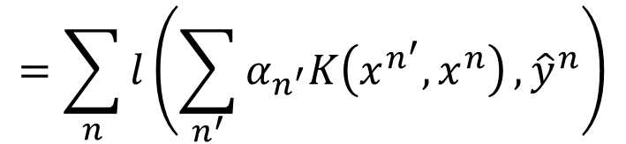
Dual Representation
Step 1:
$$f\left(x\right)=\sum_{n}{α_{n}K\left(x^{n},x\right)}$$
Step 2, 3:
Find $\left\{α_{1}^{∗},⋯,α_{n}^{∗},⋯,α_{N}^{∗}\right\}$,
minimizing loss function L
We don’t really need to know vector x
$$L\left(f\right)=\sum_{n}{l\left(f\left(x^{n}\right),{\hat{y}}^{n}\right)}$$
We only need to know the inner project between a pair of vectors x and z
$$=\sum_{n}{l\left(\sum_{n^{′}}{α_{n^{′}}K\left(x^{n^{′}},x^{n}\right)},{\hat{y}}^{n}\right)}$$
$$K\left(x,z\right)$$
Kernel Trick

Slide 16



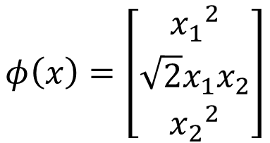
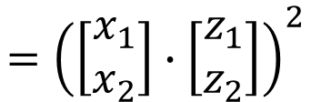
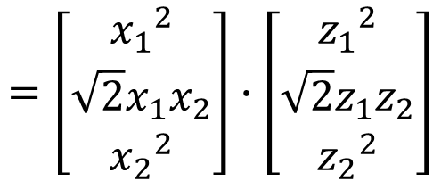
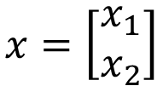


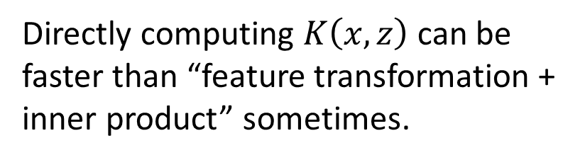
Kernel Trick
Directly computing $K\left(x,z\right)$ can be faster than “feature transformation + inner product” sometimes.
Kernel trick is useful when we transform all x to $φ\left(x\right)$
$$=\left[\begin{aligned}{x_{1}}^{2} \\ {\sqrt{2}x_{1}x}_{2} \\ {x_{2}}^{2}\end{aligned}\right]∙\left[\begin{aligned}{z_{1}}^{2} \\ {\sqrt{2}z_{1}z}_{2} \\ {z_{2}}^{2}\end{aligned}\right]$$
$$K\left(x,z\right)=$$
$$φ\left(x\right)∙φ\left(z\right)$$
$$x=\left[\begin{aligned}x_{1} \\ x_{2}\end{aligned}\right]$$
$$={x_{1}}^{2}{z_{1}}^{2}+2{x_{1}x}_{2}{z_{1}z}_{2}+{x_{2}}^{2}{z_{2}}^{2}$$
$$φ\left(x\right)=\left[\begin{aligned}{x_{1}}^{2} \\ {\sqrt{2}x_{1}x}_{2} \\ {x_{2}}^{2}\end{aligned}\right]$$
$$={\left(\left[\begin{aligned}x_{1} \\ x_{2}\end{aligned}\right]∙\left[\begin{aligned}z_{1} \\ z_{2}\end{aligned}\right]\right)}^{2}$$
$$={\left(x_{1}z_{1}+x_{2}z_{2}\right)}^{2}$$
$$={\left(x∙z\right)}^{2}$$

Slide 17


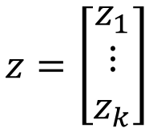



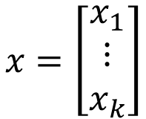
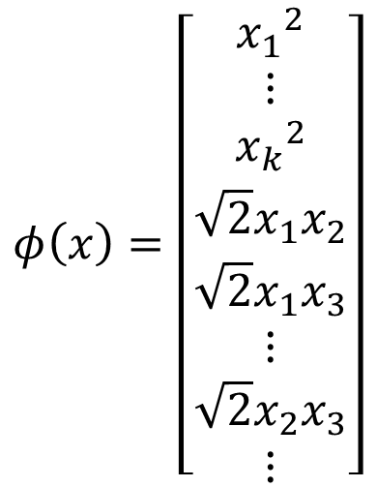

Kernel Trick
Directly computing $K\left(x,z\right)$ can be faster than “feature transformation + inner product” sometimes.
$$x=\left[\begin{aligned}x_{1} \\ ⋮ \\ x_{k}\end{aligned}\right]$$
$$z=\left[\begin{aligned}z_{1} \\ ⋮ \\ z_{k}\end{aligned}\right]$$
$$K\left(x,z\right)$$
$$={\left(x∙z\right)}^{2}$$
$$={\left(x_{1}z_{1}+x_{2}z_{2}+⋯+x_{k}z_{k}\right)}^{2}$$
$$φ\left(x\right)=\left[\begin{aligned}{x_{1}}^{2} \\ ⋮ \\ {x_{k}}^{2} \\ \sqrt{2}x_{1}x_{2} \\ \sqrt{2}x_{1}x_{3} \\ ⋮ \\ \sqrt{2}x_{2}x_{3} \\ ⋮\end{aligned}\right]$$
$$={x_{1}}^{2}{z_{1}}^{2}+{x_{2}}^{2}{z_{2}}^{2}+⋯+{x_{k}}^{2}{z_{k}}^{2}$$
$$+2x_{1}x_{2}z_{1}z_{2}+2x_{1}x_{3}z_{1}z_{3}+⋯$$
$$+2x_{2}x_{3}z_{2}z_{3}+2x_{2}x_{4}z_{2}z_{4}+⋯$$
$$=φ\left(x\right)∙φ\left(z\right)$$

Slide 18

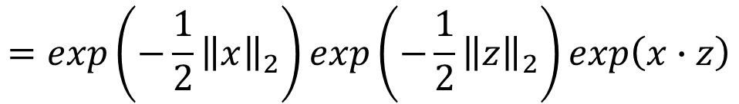
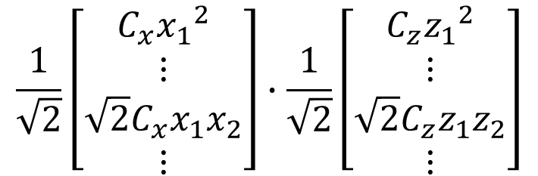











Radial Basis Function Kernel
$$x=\left[\begin{aligned}x_{1} \\ x_{2} \\ ⋮\end{aligned}\right]$$
$$z=\left[\begin{aligned}z_{1} \\ z_{2} \\ ⋮\end{aligned}\right]$$
$$=exp\left(−\frac{1}{2}{\left\|x−z\right\|}_{2}\right)$$
$$K\left(x,z\right)$$
$$=φ\left(x\right)∙φ\left(z\right)?$$
$$=exp\left(−\frac{1}{2}{\left\|x\right\|}_{2}−\frac{1}{2}{\left\|z\right\|}_{2}+x∙z\right)$$
$φ\left(∗\right)$ has inf dim!!!
$$=exp\left(−\frac{1}{2}{\left\|x\right\|}_{2}\right)exp\left(−\frac{1}{2}{\left\|z\right\|}_{2}\right)exp\left(x∙z\right)$$
$$=C_{x}C_{z}exp\left(x∙z\right)$$
$$=C_{x}C_{z}\sum_{i=0}^{∞}{\frac{{\left(x∙z\right)}^{i}}{i!}}$$
$$=C_{x}C_{z}+C_{x}C_{z}\left(x∙z\right)+C_{x}C_{z}\frac{1}{2}{\left(x∙z\right)}^{2}⋯$$
$$\frac{1}{\sqrt{2}}\left[\begin{aligned}C_{x}{x_{1}}^{2} \\ ⋮ \\ \sqrt{2}C_{x}x_{1}x_{2} \\ ⋮\end{aligned}\right]∙\frac{1}{\sqrt{2}}\left[\begin{aligned}C_{z}{z_{1}}^{2} \\ ⋮ \\ \sqrt{2}C_{z}z_{1}z_{2} \\ ⋮\end{aligned}\right]$$
$$\left[\begin{aligned}C_{x}x_{1} \\ C_{x}x_{2} \\ ⋮\end{aligned}\right]∙\left[\begin{aligned}C_{z}z_{1} \\ C_{z}z_{2} \\ ⋮\end{aligned}\right]$$
$$\left[C_{x}\right]∙\left[C_{z}\right]$$

Slide 19










Sigmoid Kernel
$$K\left(x,z\right)=tanh\left(x∙z\right)$$
When using sigmoid kernel, we have a 1 hidden layer network.
$$f\left(x\right)=\sum_{n}{α_{n}K\left(x^{n},x\right)}$$
$$=\sum_{n}{α_{n}tanh\left(x^{n}∙x\right)}$$
$$x^{1}$$
The weight of each neuron is a data point
$$α_{1}$$
x
$$x^{2}$$
$$α_{2}$$
$$f\left(x\right)$$
The number of support vectors is the number of neurons.
$$x^{n}$$
……
$$α_{n}$$

Slide 20




You can directly design $K\left(x,z\right)$ instead of considering $φ\left(x\right),φ\left(z\right)$
When x is structured object like sequence,
hard to design $φ\left(x\right)$
$K\left(x,z\right)$ is something like similarity
(Mercer’s theory can check)
Evaluate the similarity between sequences as $K\left(x,z\right)$
Audio Segment
More about kernel design in [Bishop chapter 6.2]
Audio Segment
Hiroshi Shimodaira, Ken-ichi Noma, Mitsuru Nakai, Shigeki Sagayama, “Dynamic Time-Alignment Kernel in Support Vector Machine”, NIPS, 2002
Marco Cuturi, Jean-Philippe Vert, Oystein Birkenes, Tomoko Matsui, A kernel for time series based on global alignments, ICASSP, 2007

Slide 21
SVM related methods
Support Vector Regression (SVR)
[Bishop chapter 7.1.4]
Ranking SVM
[Alpaydin, Chapter 13.11]
One-class SVM
[Alpaydin, Chapter 13.11]

Slide 22




Deep Learning
Feature transformation
linear classifier
$$φ\left(x\right)$$
……
y₁
$$x$$
……
y₂
…
…
…
…
…
……
y_{M}
SVM
Based on kernel function
$$φ\left(x\right)$$
linear classifier
Multiple Kernel learning [Alpaydin, Chapter 13.8]
Notes:
Source of image: http://www.gipsa-lab.grenoble-inp.fr/transfert/seminaire/455_Kadri2013Gipsa-lab.pdf

